Slide 1

Chapter 2: Data Manipulation
Computer Science: An Overview Twelfth Edition
by
J. Glenn Brookshear Dennis Brylow
Copyright © 2015 Pearson Education, Inc.

Slide 2
Chapter 2: Data Manipulation
2.1 Computer Architecture
2.2 Machine Language
2.3 Program Execution
2.4 Arithmetic/Logic Instructions
2.5 Communicating with Other Devices
2.6 Program Data Manipulation
2.7 Other Architectures

Slide 3
Data Manipulation
Data manipulation is the process of changing or altering data in order to make it more readable and organized. For example, you can arrange data alphabetically to expedite the process of finding useful information. Another example of data manipulation is website management

Slide 4
Computer Architecture
Computer architecture is the organization of the components which make up a computer system and the meaning of the operations which guide its function. It defines what is seen on the machine interface, which is targeted by programming languages and their compilers.

Slide 5
Computer Architecture
Central Processing Unit (CPU) or processor
Arithmetic/Logic unit versus Control unit
Registers
General purpose
Special purpose
Bus
Motherboard

Slide 6
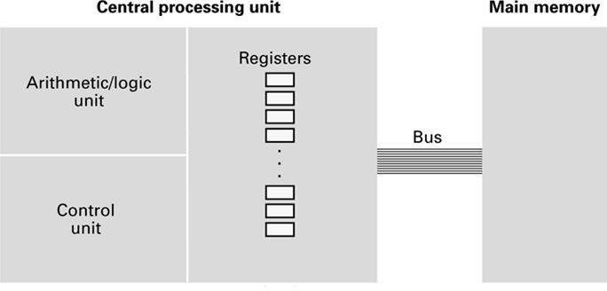
Figure 2.1 CPU and main memory connected via a bus

Slide 7
Stored Program Concept
A program can be encoded as bit patterns and stored in main memory. From there, the CPU can then extract the instructions and execute them. In turn, the program to be executed can be altered easily.

Slide 8
Terminology
Machine instruction: An instruction (or command) encoded as a bit pattern recognizable by the CPU
Machine language: The set of all instructions recognized by a machine

Slide 9
Machine Language Philosophies
Reduced Instruction Set Architecture (RISC) –
The main idea behind this is to make hardware simpler by using an instruction set composed of a few basic steps for loading, evaluating, and storing operations just like a load command will load data, a store command will store the data.
Complex Instruction Set Architecture (CISC) –
The main idea is that a single instruction will do all loading, evaluating, and storing operations just like a multiplication command will do stuff like loading data, evaluating, and storing it, hence it’s complex. Or performing all arithmetic operations with addition operator.

Slide 10
Machine Language Philosophies
Reduced Instruction Set Computing (RISC)
Few, simple, efficient, and fast instructions
Examples: PowerPC from Apple/IBM/Motorola and ARM
Complex Instruction Set Computing (CISC)
Many, convenient, and powerful instructions
Example: Intel

Slide 11
Machine Instruction Types
Data Transfer: copy data from one location to another
Arithmetic/Logic: use existing bit patterns to compute a new bit patterns
Control: direct the execution of the program

Slide 12
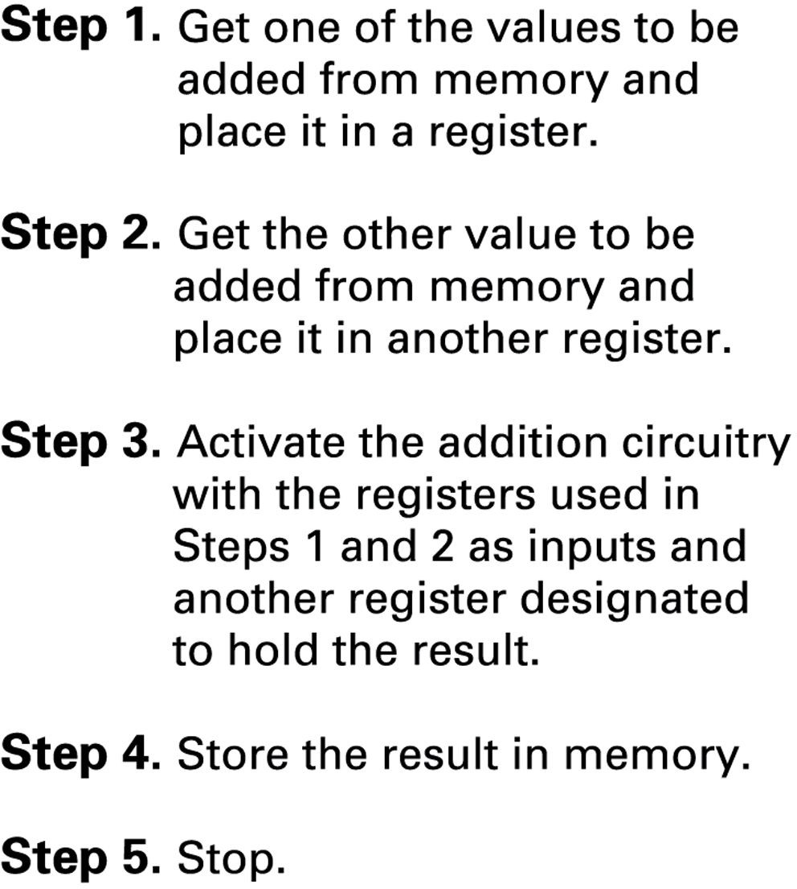
Figure 2.2 Adding values stored in memory

Slide 13
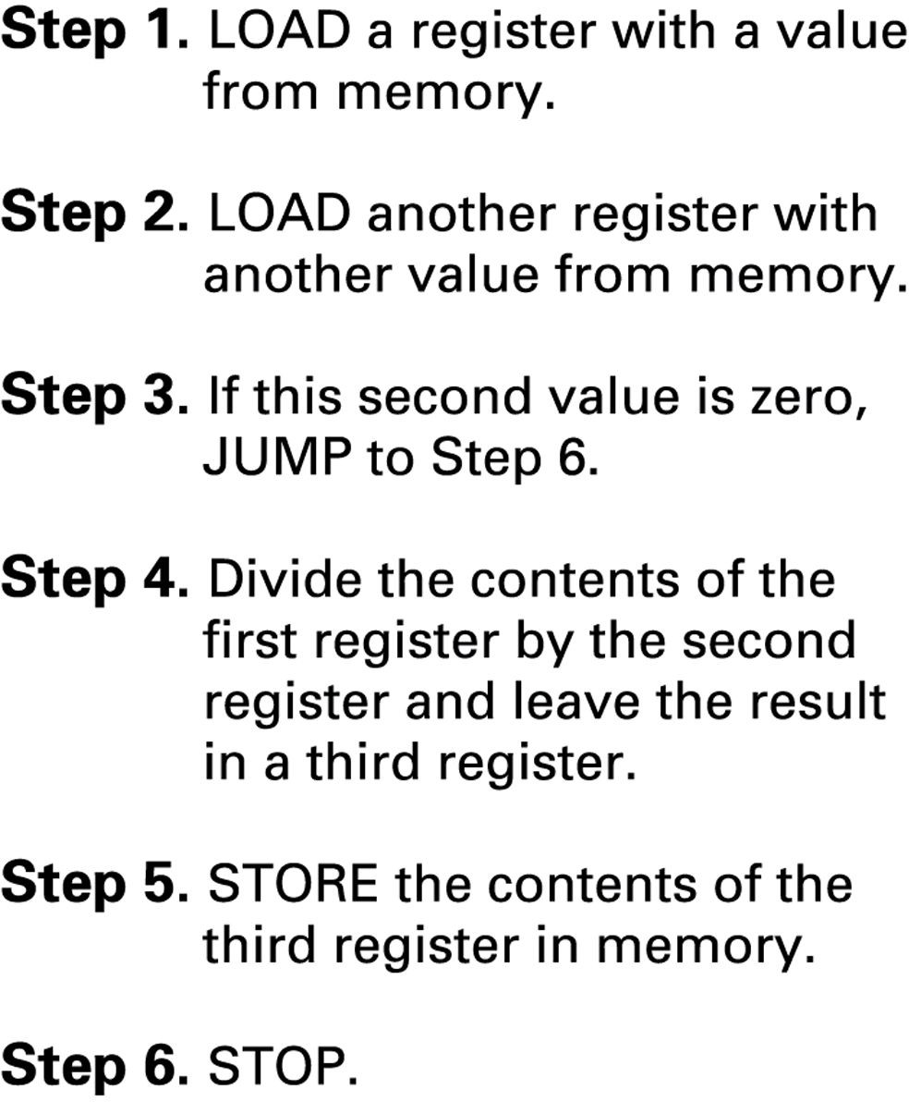
Figure 2.3 Dividing values stored in memory

Slide 14
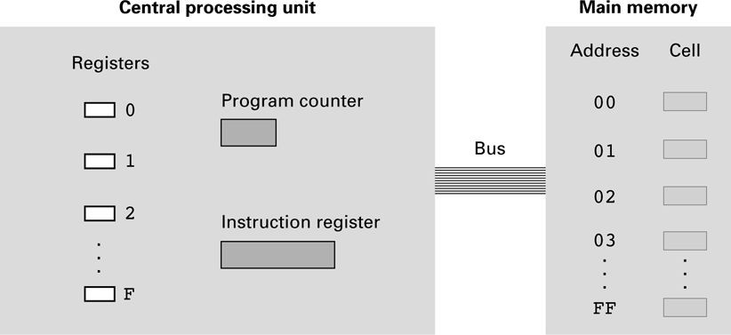
Figure 2.4 The architecture of the machine described in Appendix C

Slide 15
Parts of a Machine Instruction
Op-code: Specifies which operation to execute
Operand: Gives more detailed information about the operation
– Interpretation of operand varies depending on op-code

Slide 16
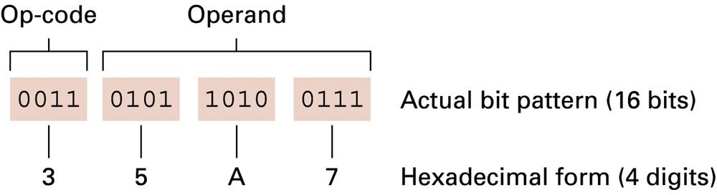
Figure 2.5 The composition of an instruction for the machine in Appendix C

Slide 17
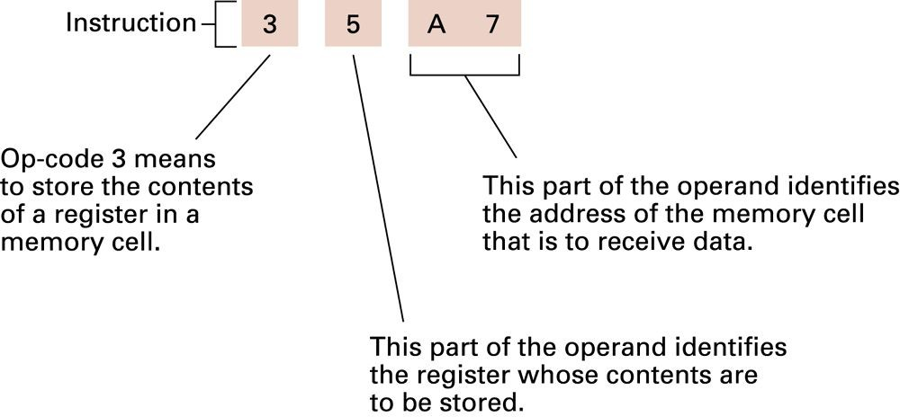
Figure 2.6 Decoding the instruction 35A7

Slide 18
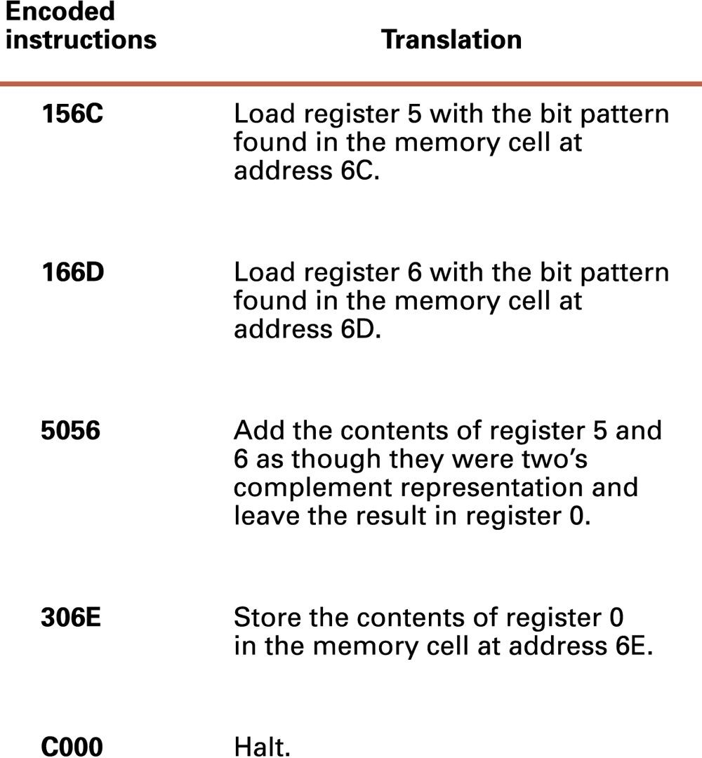
Figure 2.7 An encoded version of the instructions in Figure 2.2

Slide 19
Program Execution
Controlled by two special-purpose registers
Program counter: address of next instruction
Instruction register: current instruction
Machine Cycle
Fetch
Decode
Execute

Slide 20
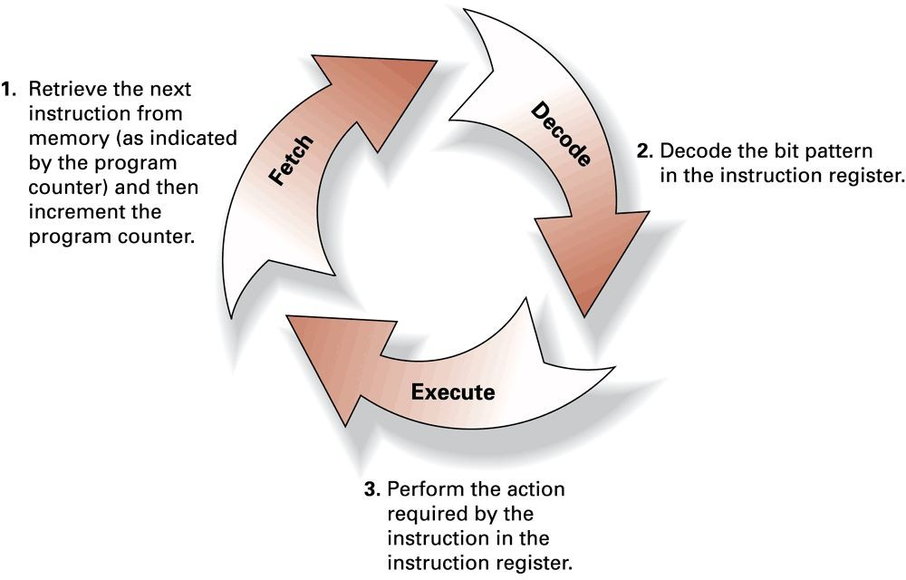
Figure 2.8 The machine cycle

Slide 21
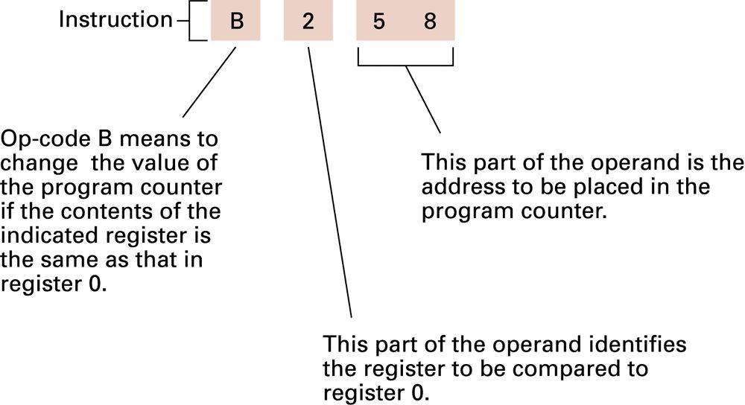
Figure 2.9 Decoding the instruction B258

Slide 22
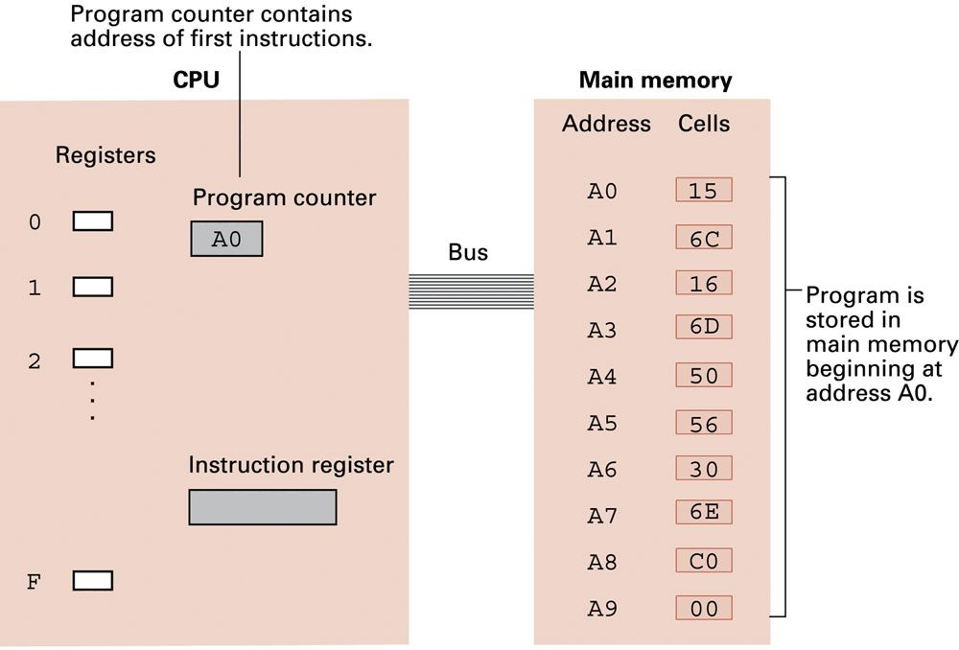
Figure 2.10 The program from Figure 2.7 stored in main memory ready for execution

Slide 23
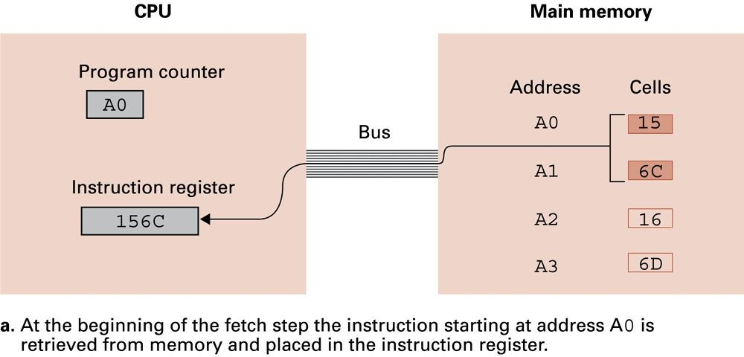
Figure 2.11 Performing the fetch step of the machine cycle

Slide 24
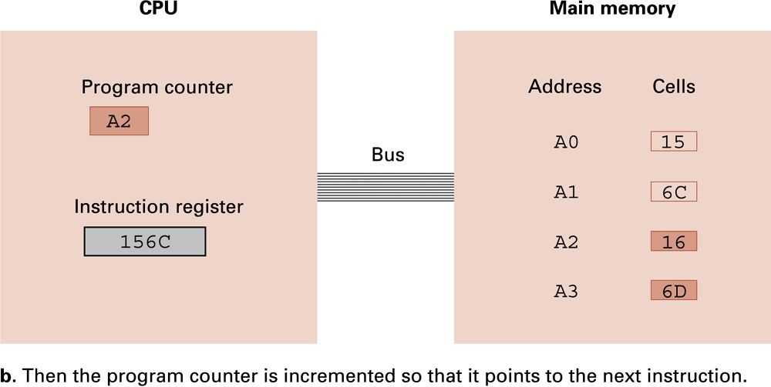
Figure 2.11 Performing the fetch step of the machine cycle (continued)

Slide 25
Logic Gates
A logic gate is a device that acts as a building block for digital circuits. They perform basic logical functions that are fundamental to digital circuits. Most electronic devices we use today will have some form of logic gates in them.

Slide 26
Arithmetic/Logic Operations
Logic: AND, OR, XOR
Masking : A mask is a bit pattern that has been defined by a programmer, which allows specific bits in a piece of data to be tested or altered.
Rotate and Shift: circular shift, logical shift, arithmetic shift
Arithmetic: add, subtract, multiply, divide
Precise action depends on how the values are encoded (two’s complement versus
floating-point).

Slide 27
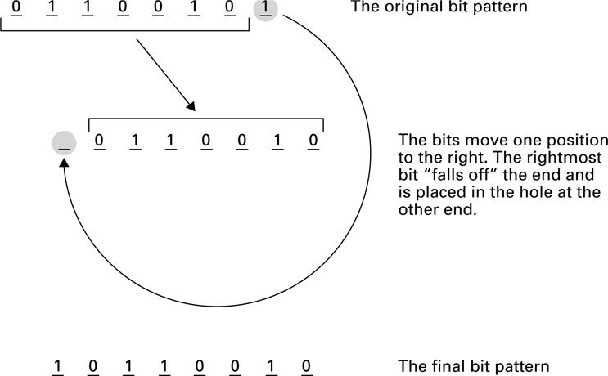
Figure 2.12 Rotating the bit pattern 65 (hexadecimal) one bit to the right

Slide 28
Left/Right Shift
SHIFT RIGHT bitwise operator - shift all the bits one place to the right. Discard the original LSB and replace the MSB with a 0.
Example 9 >> 10100011
7 | 6 | 5 | 4 | 3 | 2 | 1 | 0 | Bit position
1 | 0 | 1 | 0 | 0 | 0 | 1 | 1 | Data
0 | 1 | 0 | 1 | 0 | 0 | 0 | 1 | SHIFT RIGHT result
LEFT SHIFT bitwise operator - shift all the bits one place to the left. Discard the original MSB and replace the LSB with a 0.
Example 11 << 11000001
7 | 6 | 5 | 4 | 3 | 2 | 1 | 0 | Bit position
1 | 1 | 0 | 0 | 0 | 0 | 0 | 1 | Data
1 | 0 | 0 | 0 | 0 | 0 | 1 | 0 | SHIFT LEFT result

Slide 29
Communicating with Other Devices
Controller: An intermediary apparatus that handles communication between the computer and a device
Specialized controllers for each type of device
General purpose controllers (USB and FireWire)
Port: The point at which a device connects to a computer
Memory-mapped I/O: CPU communicates with peripheral devices as though they were memory cells

Slide 30
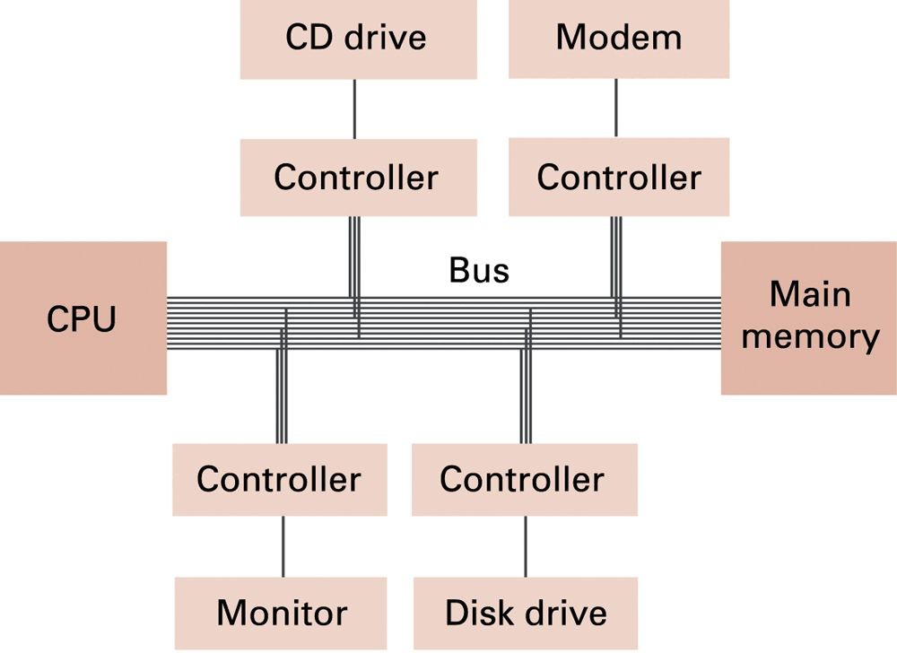
Figure 2.13 Controllers attached to a machine’s bus

Slide 31
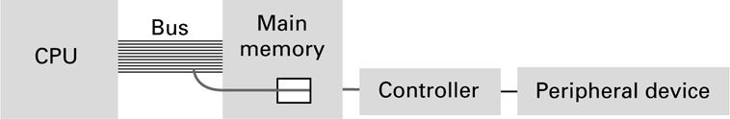
Figure 2.14 A conceptual representation of memory-mapped I/O

Slide 32
Communicating with Other Devices
(continued)
Direct memory access (DMA): Main memory access by a controller over the bus
Handshaking: The process of coordinating the transfer of data between components

Slide 33
Communicating with Other Devices
(continued)
Parallel Communication: Several communication paths transfer bits simultaneously.
Serial Communication: Bits are transferred one after the other over a single communication path.

Slide 34
Data Communication Rates
Measurement units
Bps: Bits per second
Kbps: Kilo-bps (1,000 bps)
Mbps: Mega-bps (1,000,000 bps)
– Gbps: Giga-bps (1,000,000,000 bps)
Bandwidth: Maximum available rate

Slide 35
Programming Data Manipulation
Programing languages shields users from details of the machine:
A single Python statement might map to one, tens, or hundreds of machine instructions
Programmer does not need to know if the processor is RISC or CISC
Assigning variables surely involves LOAD, STORE, and MOVE op-codes

Slide 36
Parallel Processing
Running two or more processors (CPUs) to handle separate parts of an overall task.
Breaking up different parts of a task among multiple processors will help reduce the amount of time to run a program.
Any system that has more than one CPU can perform parallel processing, as well as multi-core processors which are commonly found on computers today.

